Slide 1



PY-EXPO
2K24
Team ID:f67b63e3f4
Team Name: Deadline team
Genius innovation leaves behind a legacy...
PYEXPO 2K24

Slide 2
PS Code: py162
Problem Statement:campus traffic analysis
02
PYEXPO 2K24

Slide 3
Solution:
* Real time data collection
* Data processing
* Resource allocation
* Live recording
* Navigation assistant within the campus area
*Traffic analysis algorithm
*Testing and quality
03
PYEXPO 2K24

Slide 4
WORKING:
YOLOv8 Integration:
YOLOv8 detects vehicles in real-time from camera feeds.
It predicts bounding boxes around detected vehicles.
YOLOv8 sends bounding box coordinates and confidence scores to Django
.
04
PYEXPO 2K24

Slide 5
Django Implementation:
Django provides a web interface for users to interact with the parking system.
It manages the database storing parking spot availability and reservations.
Django integrates with YOLOv8 by processing detection results and updating the database accordingly.
By combining YOLOv8's object detection capabilities with Django's web framework, the campus parking system can efficiently monitor parking spot occupancy and provide real-time updates to users.
05
PYEXPO 2K24

Slide 6
TECHNICAL STACK:
Programming language: python
Frontend: HTML,CSS
Analysis: Machine language, yolov8
Web framework: Django framework
Computervision: opencv
06
PYEXPO 2K24

Slide 7
FLOW CHART:
DATASET → KAGGLE
|
Bounding box----→LabellingCOCO
|
YOLO V8
|
PRE TRAINED MODEL
|
DASHBOARD
|
Django
06
PYEXPO 2K24

Slide 8
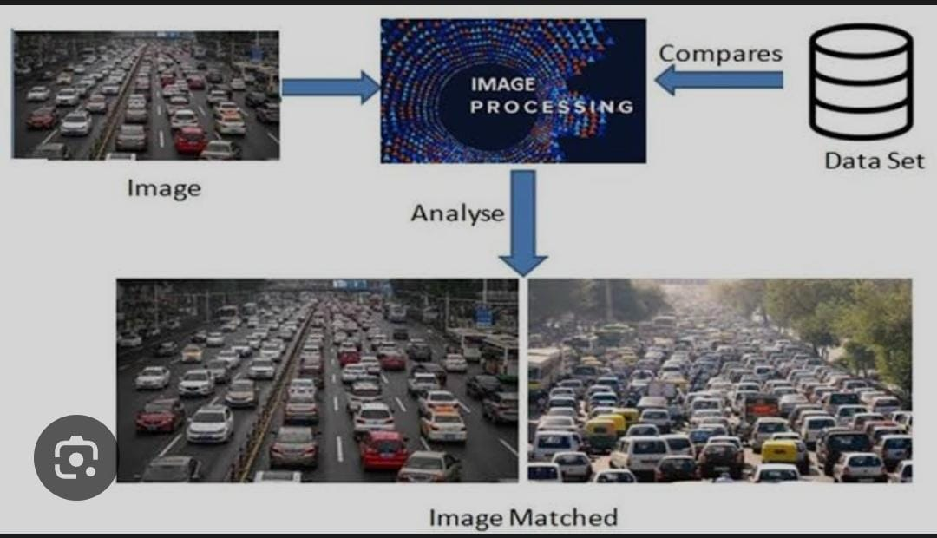

07
PYEXPO 2K24

Slide 9
Team Member Details:
Team leader:
Samitha K. 23ecb23
Team members:
Sooriya.S 23ecb37
Vignesh Bala.R. 23ecb58
Vishnu kumaran.L 23ecb61
08
PYEXPO 2K24

Slide 10
Thank You
Any Queries?
PYEXPO 2K24

